Slide 1
Data Frames
Lesson 6 Practice Hands-On
Darren Besabella

Slide 2
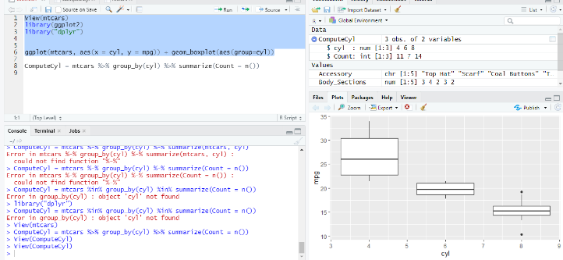
Box Plot
Code & Graph

Slide 3
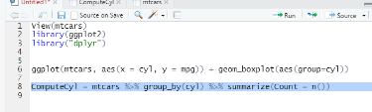
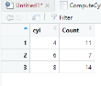
Table - group by cylinders per car

